Slide 1
Detection of Human Biological Emotions using OpenCV and TensorFlow
Seminar II
Guided By:
Prof.: D. J. Choudhari
HOD,Computer Science and Engineering , GCOEC

Slide 2
Introduction:
Human emotions are natural expressions that people tend to make naturally, instead of any conscious effort that is accompanied by the reflexing of facial muscles
Human can quickly and even subconsciously assess a multitude of indicator such as word choice, voice inflection, and body language to discern the sentiment of other.
OpenCV and Tensorflow are used to make the system which contain face recognition, emotion detection, drowsiness detection and ID card detection.
This system can be used as a second layer of security where along with the face the emotion is also detection.
This can also be useful to verify that the person in front of camera is not just a 2-dimention representation.
The system will detect the face from the given image, after processing it and on the basis of the expression, the emotion will be recognized.

Slide 3
Problem Statement:
Nowadays, more and more intelligent system are using emotion recognition models to improve their interaction with humans. This is important, as the system can adopt their responses and behavioral patterns according to the human emotion and make more natural.
In mass processions individuals’ can show repulsive and violent behavior, such individual shows a pre-emotions such as anger, or despair. Which when identified using emotion recognition can avert disastrous events. Also using such emotions detection public places can be equipped with solution to suppress these behaviors.

Slide 4
Objective of the project
The objective of the project is to be an affordable and efficient product that can detect emotions based of input images sources.
The objective of this project is to develop a system which can analyze the image and predict the expression of the person.
An important domain where we see the importance of emotion detection is for business promotions. Most of the businesses thrive on customer responses to their product and offers.
The main purpose of this system is to classify human emotion based on their facial appearance Here are the different type of emotion: anger, happy, supplies, sad, fear, disgust, peace, sorrow, courage.

Slide 5
Literature Survey:
Face recognition and emotion analysis is a process in the field of digital imagery and computational analysis , by providing resources to be used as biometric verification and security surveillance.
Mollahosseini propose deep CNN for FER across several available databases.
After feature are extracted and images reduced to 48*48 frame, augmented data techniques are applied.
Two convolution-pooling network with inception styles modules.
this techniques allows reduction on over fitting problem.
Lopes Studied the impact of data pre-processing before the training the network in order to have a better emotion classification.
Data augmentation, rotation correction, cropping, down sampling with 32x32 pixels and intensity normalization
Two convolution network with 256 and 7 neurons ,best weight gained at the training stage are used
This experience was evaluated in three accessible databases: CK+, JAFFE, BU-3DFE. Researchers shows that combining all of these pre-processing steps is more effective than applying them separately.

Slide 6
Detection of the essential parts of the face was proposed by Yolcu et al.
They used three CNN with same architecture each one detect a part of the face such as eyebrow, eye and mouth. This method offers better accuracy than the use raw images or iconize face alone
Deepak jain propose a novel deep CNN witch contain two residual blocks, each one contain four convolution layer. These model trains on JAFFE and CK+ databases after a pre-processing step, which allows cropping and normalizing the intensity of the images.
Kim studies variation facial expression during emotional state.
they propose a spatio-temporal architect with a combination between CNN and LSTM.
Agrawal and Mittal make a study of the influence variation of the CNN parameters on the recognition rate using FER2013 database. According to these studies, researchers create two novel models of CNN achieve average 65.23% and 65.77% of accuracy.
64*64 frame size is transferred through various filter and size alteration, optimizer: adam, SGD, adadelta
Softmax function for classification

Slide 7
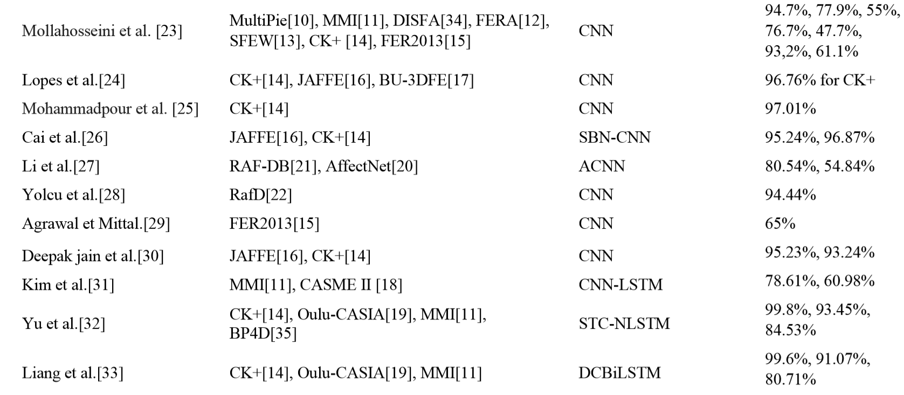
Wafa Mellouka, Wahida Handouzia
“Facial emotion recognition using deep learning: review and insights”
performed various compares between different proposed algorithms and techniques.. The statically concluded values of these techniques as:
Author Dataset Algorithm Accuracy

Slide 8
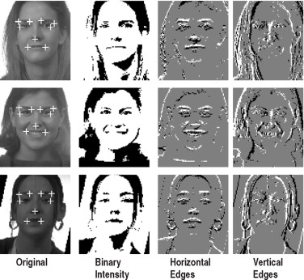
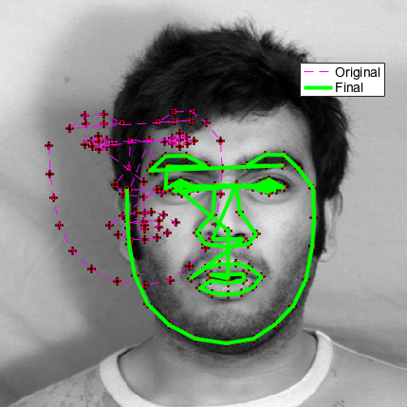
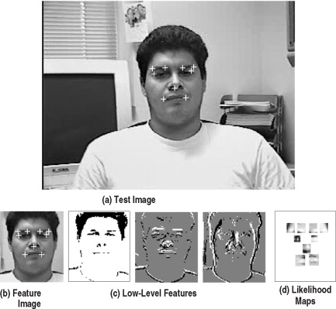
Methods in face detection.
The human face is a dynamic object and has a degree of variability in its appearance
Feature-based approaches for face detection
Low-level analysis
Edges : a line-follower implemented with the curvature constraint to prevent it from being distracted by noisy edges
Grey-level : searches for local gray minima within segmented facial regions.
Color information in face detection : color thresholds where skin color is modeled through histograms or charts converting RGB colors into YIQ representation.
Motion-based analysis : achieve motion segmentation is by frame difference analysis.
Active shape model : Active shape models depict the actual physical and, gradually deforms to take the shape of the feature
Feature analysis : determination of prominent facial features and hypothesizing other less prominent features using anthropometric measurements
Image-based approaches for face: classifies examples into face and non-face prototype classes. Comparison between these classes and a 2D intensity array extracted from an input image allows the decision of face existence to be made
Statistical approaches: The training procedure results in a set of look-up tables with likelihood ratios.
Edge analysis
Active shape model
Low level feature analysis

Slide 9
Methods in Face Recognition
Face recognition is the process of detecting face in an image and then using algorithms to identify who the face belongs to. Face recognition is thus a form of person identification
Geometric feature-based method -Combination of geometric characteristics and distance between detected significant facial features to represent face
Subspace-based face recognition -use a training set to compute a coordinate space
Neural network-based face recognition-The basic idea is to consider a net with a neuron for every pixel in the image. the face image, is approximated by a vector with smaller dimensions by the first network (auto-association), and then this vector is finally used as input for the classification net
Correlation-based method -computation of the normalized cross correlation coefficient.
Matching pursuit-based methods best decomposition of a set of images by iteratively optimizing a cost function
Support vector machine approach is a K class problem.

Slide 10
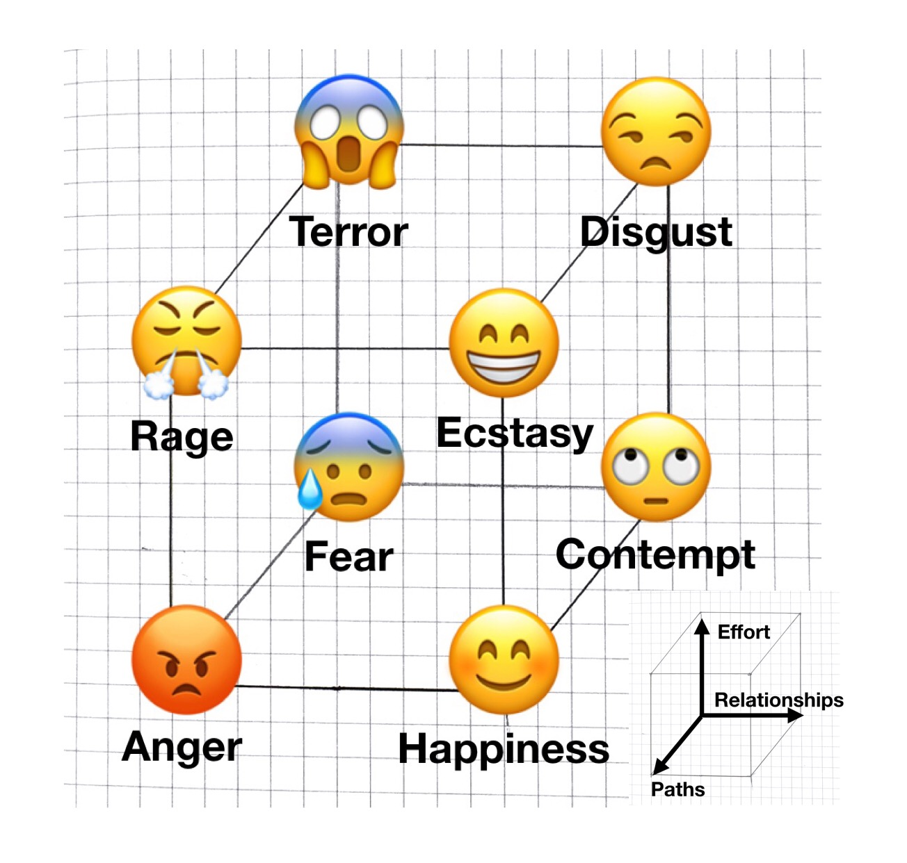
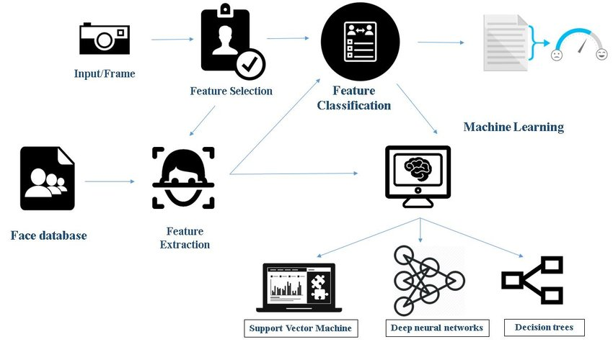
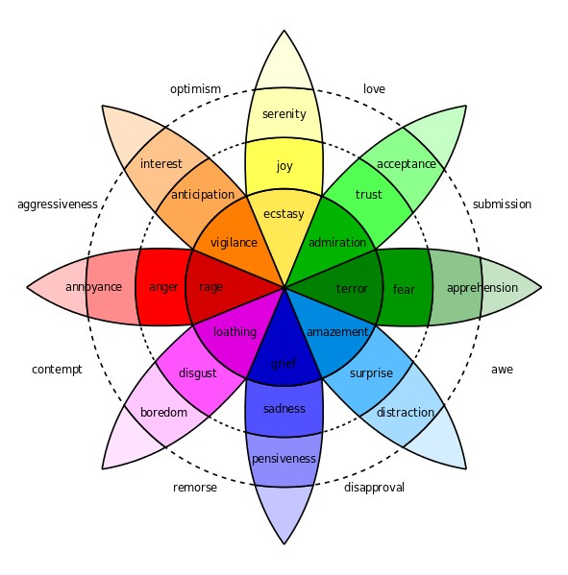
Emotion identification
Emotion identification is the process of identifying human emotion from the feature set identified as from the various methods of face detection and identification.
The data set and vectors received by various algorithms are transferred to various network and preceptory and statistical models.
The models validate the feature vectors against known models and generate probabilistic data. The various methods used are:
Support vector machine-support-vector machines are supervised learning models with associated learning algorithms that analyze data used for classification and regression analysis
Deep neural networks-A deep neural network (DNN) is an artificial neural network (ANN) with multiple layers between the input and output layers
Decision tree-A decision tree is a decision support tool that uses a tree-like model of decisions and their possible consequences, including chance event outcomes, resource costs, and utility.
Lövheim Cube of Emotions - presents signal substances forming the axis of the coordination system and the eight basic emotions are placed at the eight corners of the cube.
Plutchik’ model: [19]Plutchik gave a hybrid model arranging the emotions into concentric circles with inner being the basic and the outer more complex emotions.
Lövheim Cube of Emotions
Plutchik’ model

Slide 11
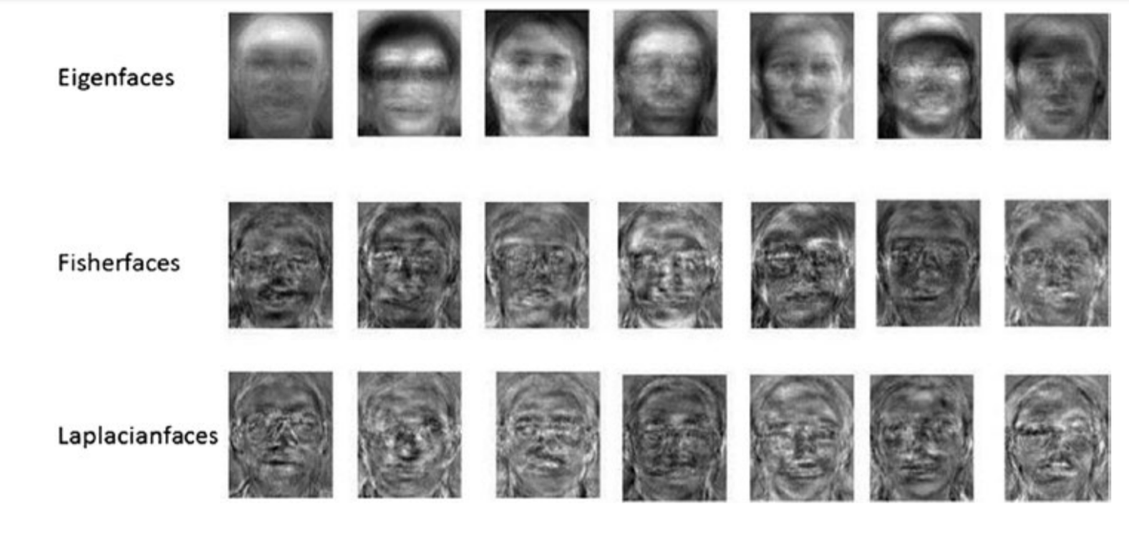
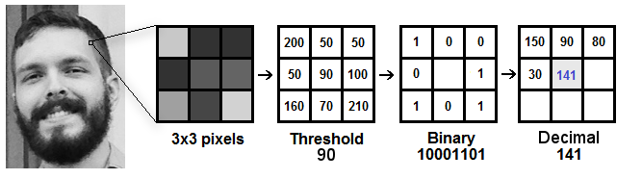
Methodology:
The detection and recognition implementation proposed here is a supervised learning modal that will use the one-versus-all (OVA) approach to train and predict the seven basic emotion (anger, contempt, disgust, fear, happiness, sadness, and surprise), using OpenCV and Tensorflow.
OpenCV provides various algorithms for face detection and identification
•Eigen faces:Involves projecting face images from a higher dimension to lower dimension.
• Fisher faces: Data is assumed to be uniformly distributed in each class
• Local Binary Patterns Histograms: labels the pixels of an image by thresholding the neighborhood of each pixel and considers the result as a binary number.
Fig. Sample images of various algorithms

Slide 12
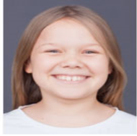
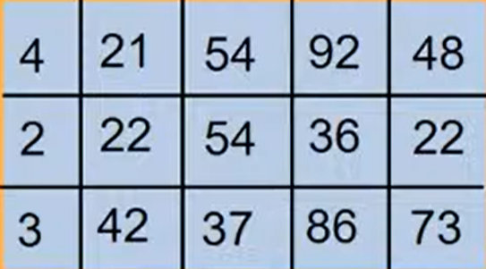
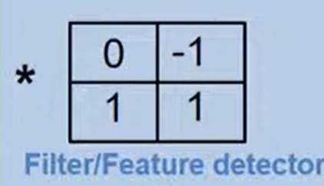
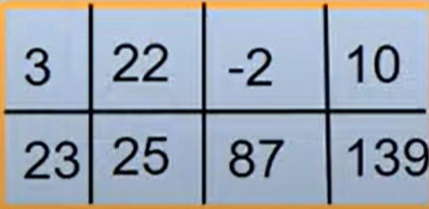

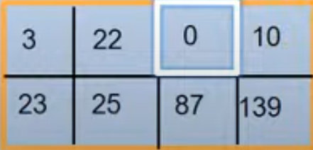

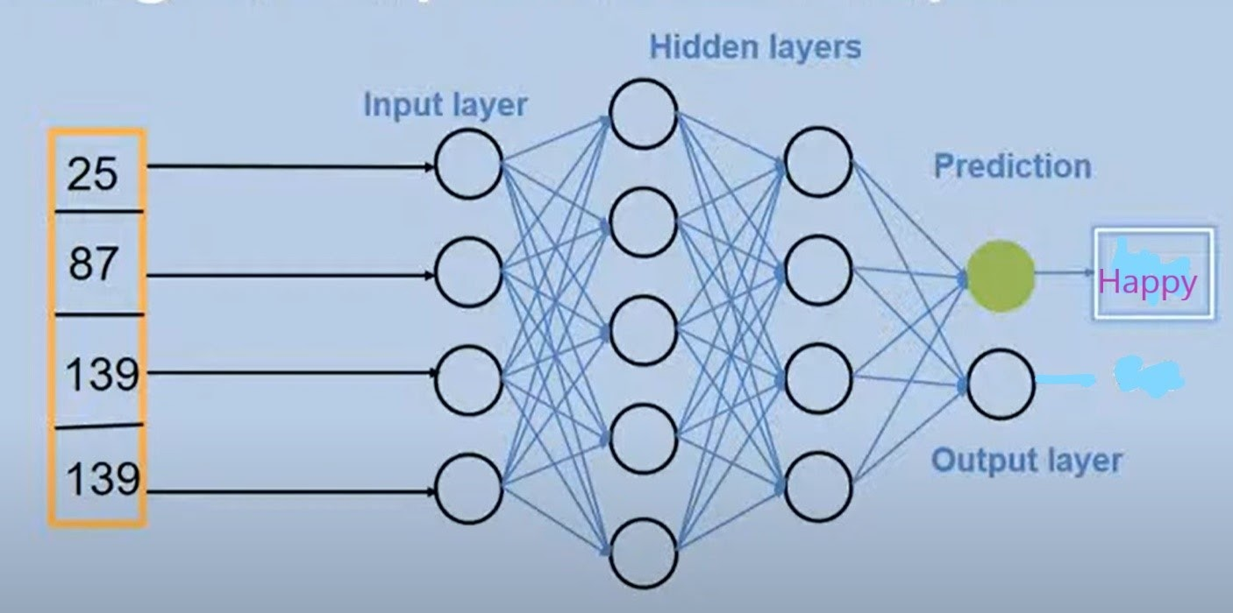
OpenCV provides methods for face detection and identification.
Classification and Reorganization of image is done through a CNN model trained using feature sets.
The model to be used in feature detection contains:
1.Convolution Layer:Convert images into array.
2.ReLu Layer: It is a half rectifier. Converts negative value to zero.
3.Pooling Layer:Helps to Control over fitting
4.Fully connected layer: Combines all the features together to create a final model

Slide 13
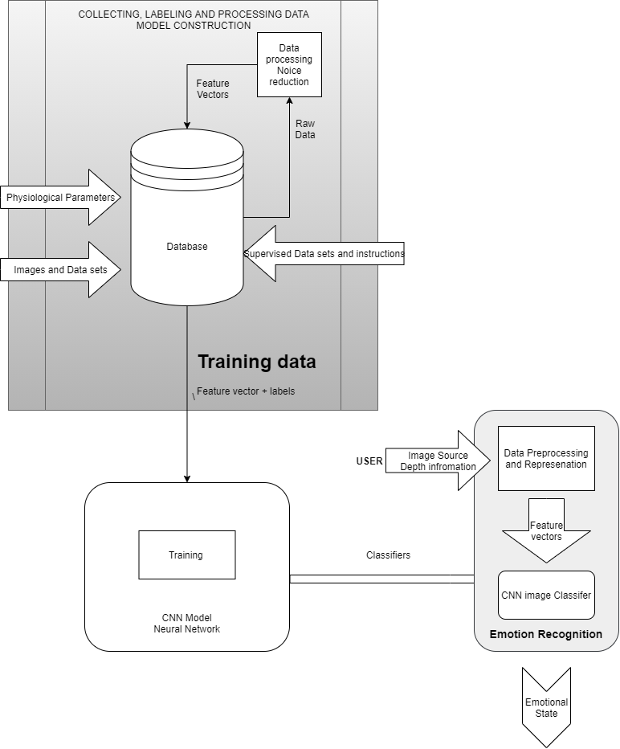
CNN process flow

Slide 14
Hardware/Software Requirement
Hardware specification:
Processor: Intel i5 1.2 GHz or higher AMD
Ryzen 3 2.0 GHz or higher
Ram: 8 GB DDR4 2400 MHz or higher
Host OS: Windows 7 SP1, Ubuntu Linux 16.07 or higher
with webcam support
Software specification:
Front-End: Python, C++
Development Environment: JetBrains Pycharm 2020.2.1
Back-End: OpenCV 2.4.13.7, TensorFlow Core 2.3.0
UI Interfacing: PyQt, Tk
VCS (Version Control System): Local – Git 2.27
Cloud- Microsoft Github

Slide 15
References:
Wan, S., & Aggarwal, J. K. (2013, April). A scalable metric learning-based voting method for expression recognition . In Automatic Face and Gesture Recognition (FG), 2013 10TH IEEE International Conference and Workshops on (pp. 1-8). IEEE,
[OpenCV Dev Team] “Welcome to opencv documentation!” Dec 31, 2019 , Access Online: September 9, 2020 , Available : https://docs.opencv.org/2.4/index.html
M. Xiaoxi, L. Weisi, H. Dongyan, D. Minghui and H. Li, "Facial emotion recognition," 2017 IEEE 2nd International Conference on Signal and Image Processing (ICSIP), Singapore, 2017, pp. 77-81, doi: 10.1109/SIPROCESS.2017.8124509.
Turabzadeh, S,; Meng, H.; Swash, R.M.; Pleva, M.; Juhar, J. Real-time emotional state detection from facial expression on embedded devices. In Proceedings of the 2017 Seventh International Conference on Innovative Computing Technology (INTECH), Luton, UK, 16-18 August 2017; pp.46-51.
“TensorFlow Core”[Online] Accessed: September 9, 2020 ,Available : https://www.tensorflow.org/guide
C. Jain, K. Sawant, M. Rehman and R. Kumar, "Emotion Detection and Characterization using Facial Features," 2018 3rd International Conference and Workshops on Recent Advances and Innovations in Engineering (ICRAIE), Jaipur, India, 2018, pp. 1-6, doi: 10.1109/ICRAIE.2018.8710406.
Facial emotion recognition using deep learning: review and insights Wafa Mellouka*, Wahida Handouzia aLaboratoire d’automatique de Tlemcen (LAT), Tlemcen university, BP 320, Chetouane Tlemcen 1300, Algeria
A. Mollahosseini, D. Chan, et M. H. Mahoor, « Going deeper in facial expression recognition using deep neural networks », in 2016 IEEE Winter Conference on Applications of Computer Vision (WACV), mars 2016, p. 1‑10, doi: 10.1109/WACV.2016.7477450
A. T. Lopes, E. de Aguiar, A. F. De Souza, et T. Oliveira-Santos, « Facial expression recognition with Convolutional Neural Networks: Coping with few data and the training sample order », Pattern Recognit., vol. 61, p. 610‑628, janv. 2017, doi: 10.1016/j.patcog.2016.07.026.

Slide 16
Thank You
Presentators:
Sagar Ramrao Bharad
Prashish Gautam Borkar
Shreya Bhojraj Gawali
Janhavi Jayant Karande
AnilKumar Ramji Sharma

